Slide 1

Data Science Presentation
JAD Solutions
Notes:
Jetze Luyten

Slide 2



Team
Jetze Luyten
Axel Van Gestel
David Silva
Notes:
Jetze Luyten

Slide 3



Agenda
Titanic Dataset
Correlations
Useful graphs
Crop Dataset
Correlations
Useful graphs
Summary
Notes:
Jetze Luyten

Slide 4

Titanic Dataset
Notes:
Jetze Luyten

Slide 5
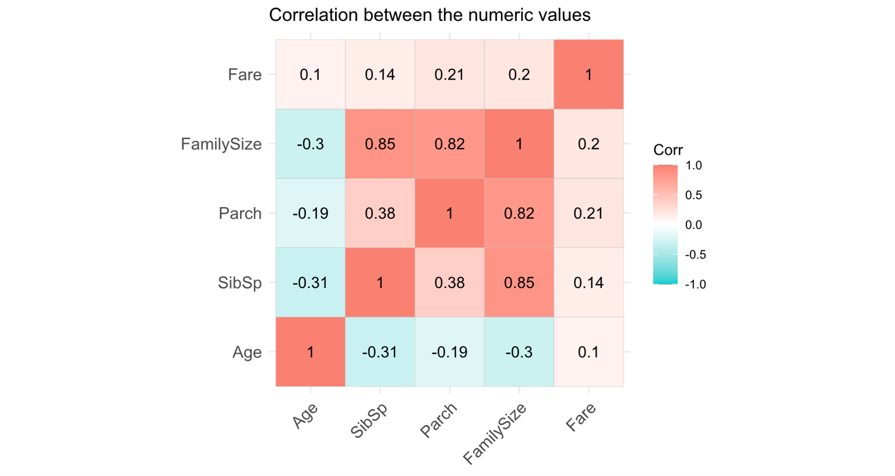
Correlation heatmap
Notes:
Axel
SibSp = Number of Siblings / Spouses aboard
Parch = Number of Parents / Children aboard
Age increases -> Number of Siblings / Family member aboard decreases

Slide 6
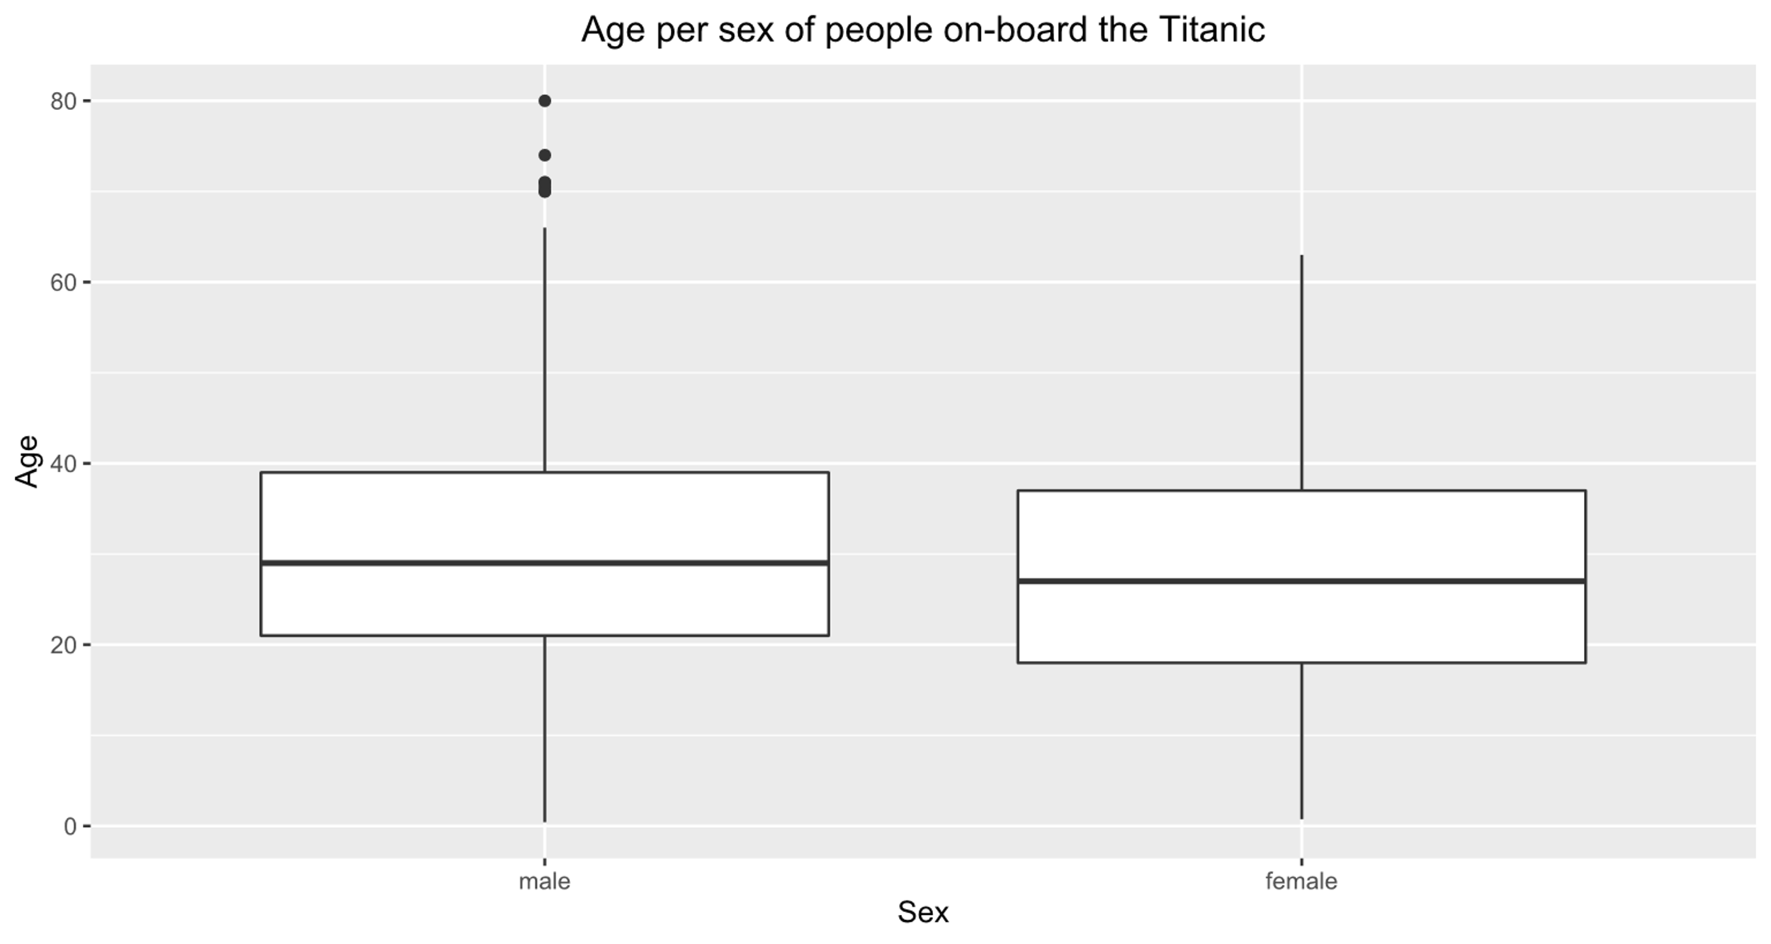
Age of people on-board the Titanic grouped by gender
Notes:
Axel
Most of the male and female passengers in the same age group
Some older male outliers

Slide 7
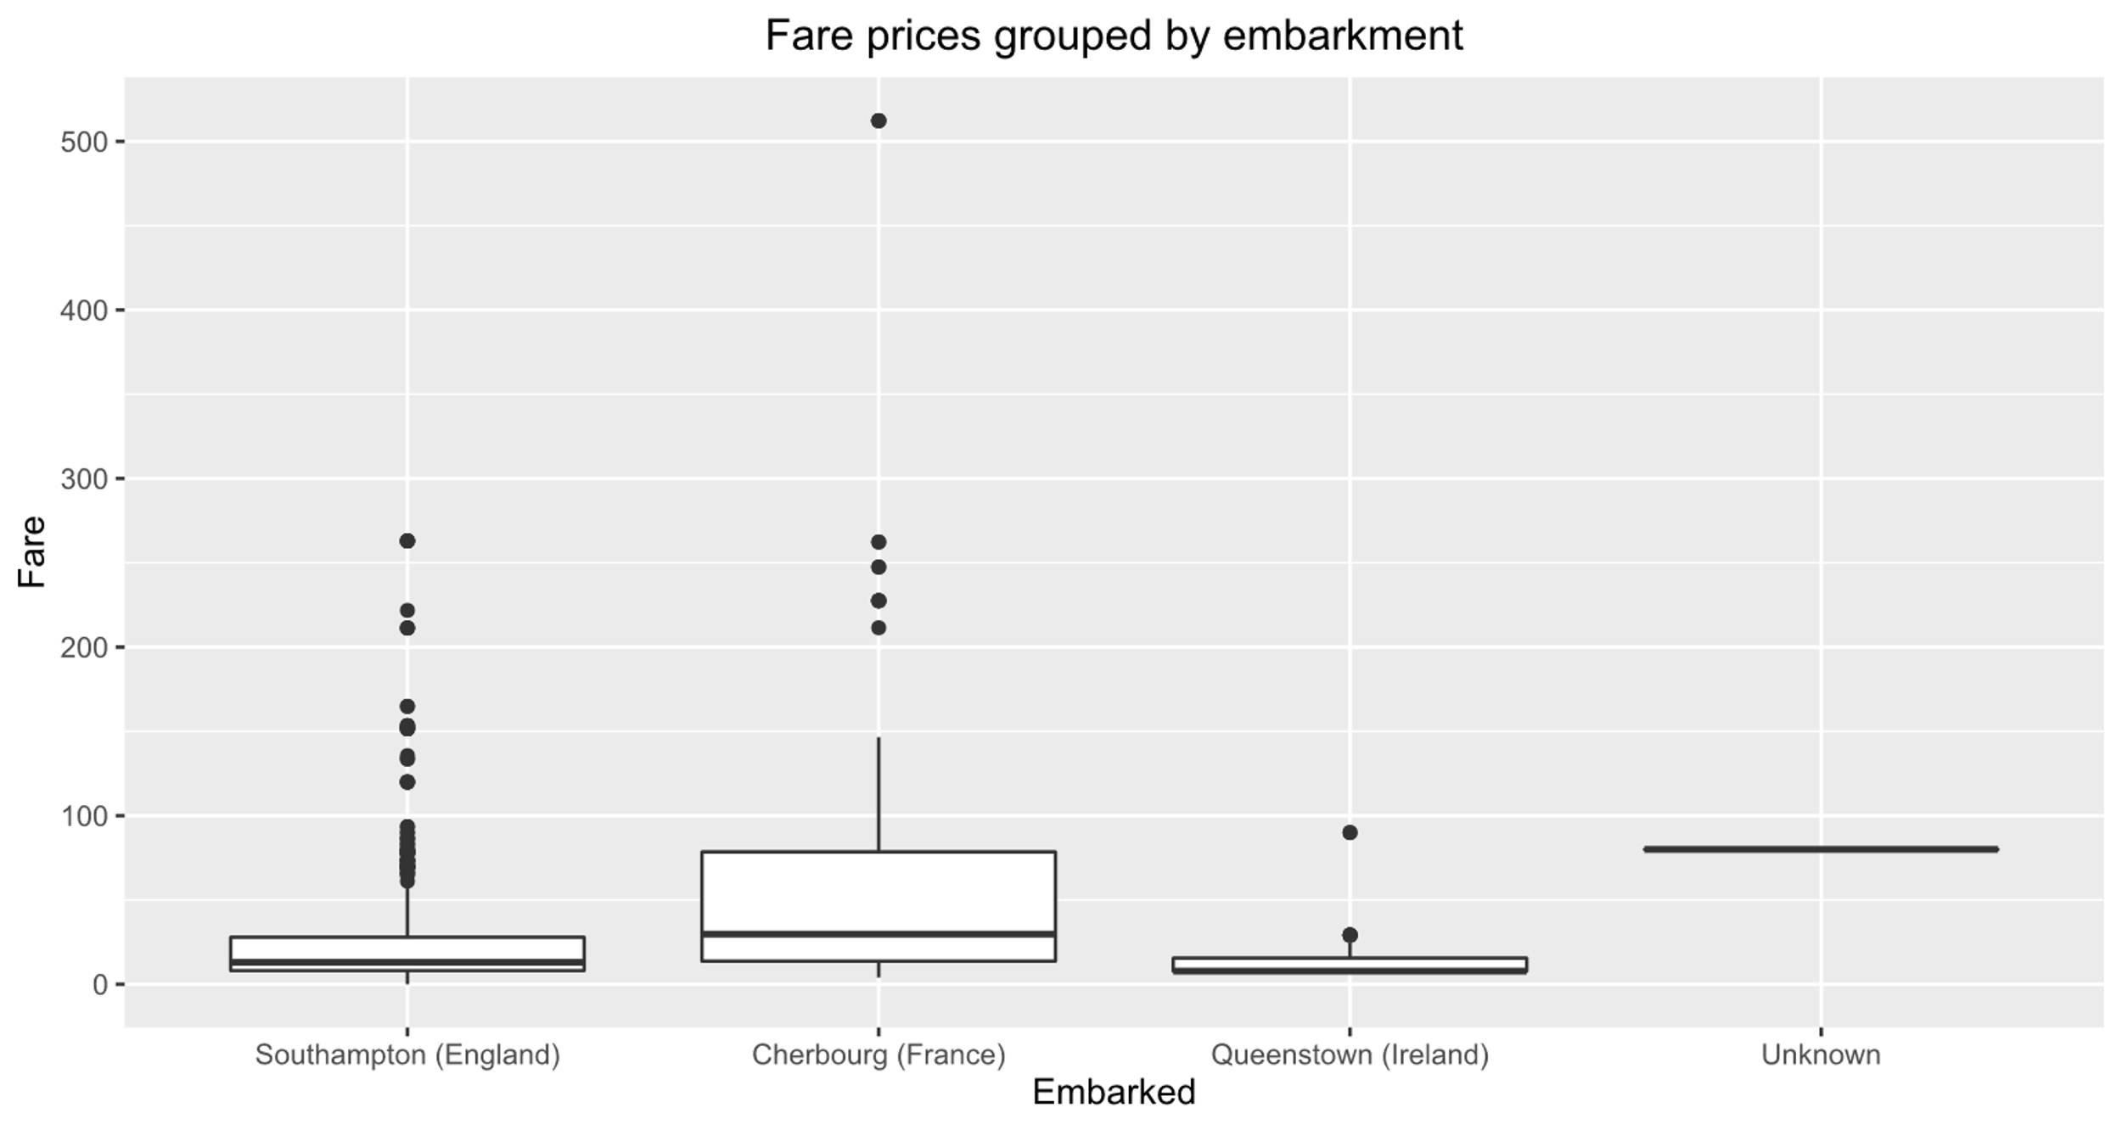
Fare prices grouped by embarkment
Notes:
Axel
Some outlier who paid over 500 pounds

Slide 8
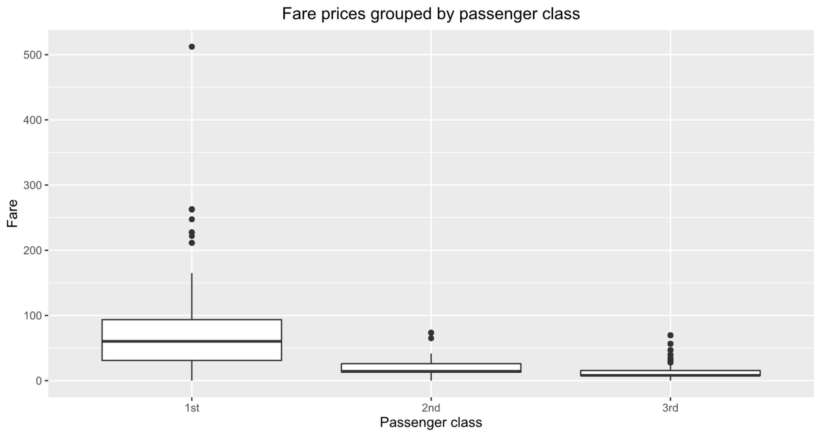
Class differences reflected in price?
Notes:
Axel
Yes, downwards trend
1st: median +- 60
2nd: median +- 15
3rd: median +- 10
High price variance in the 1st class
The 500 outlier is in the 1st class

Slide 9
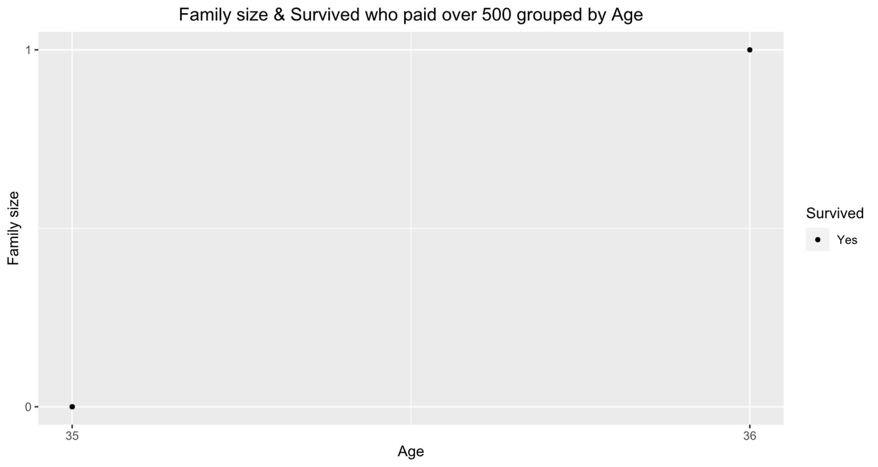
Age & family size of those who paid over 500
Notes:
Axel
Alone or 1 other family member
In their Mid-30s
All survived

Slide 10
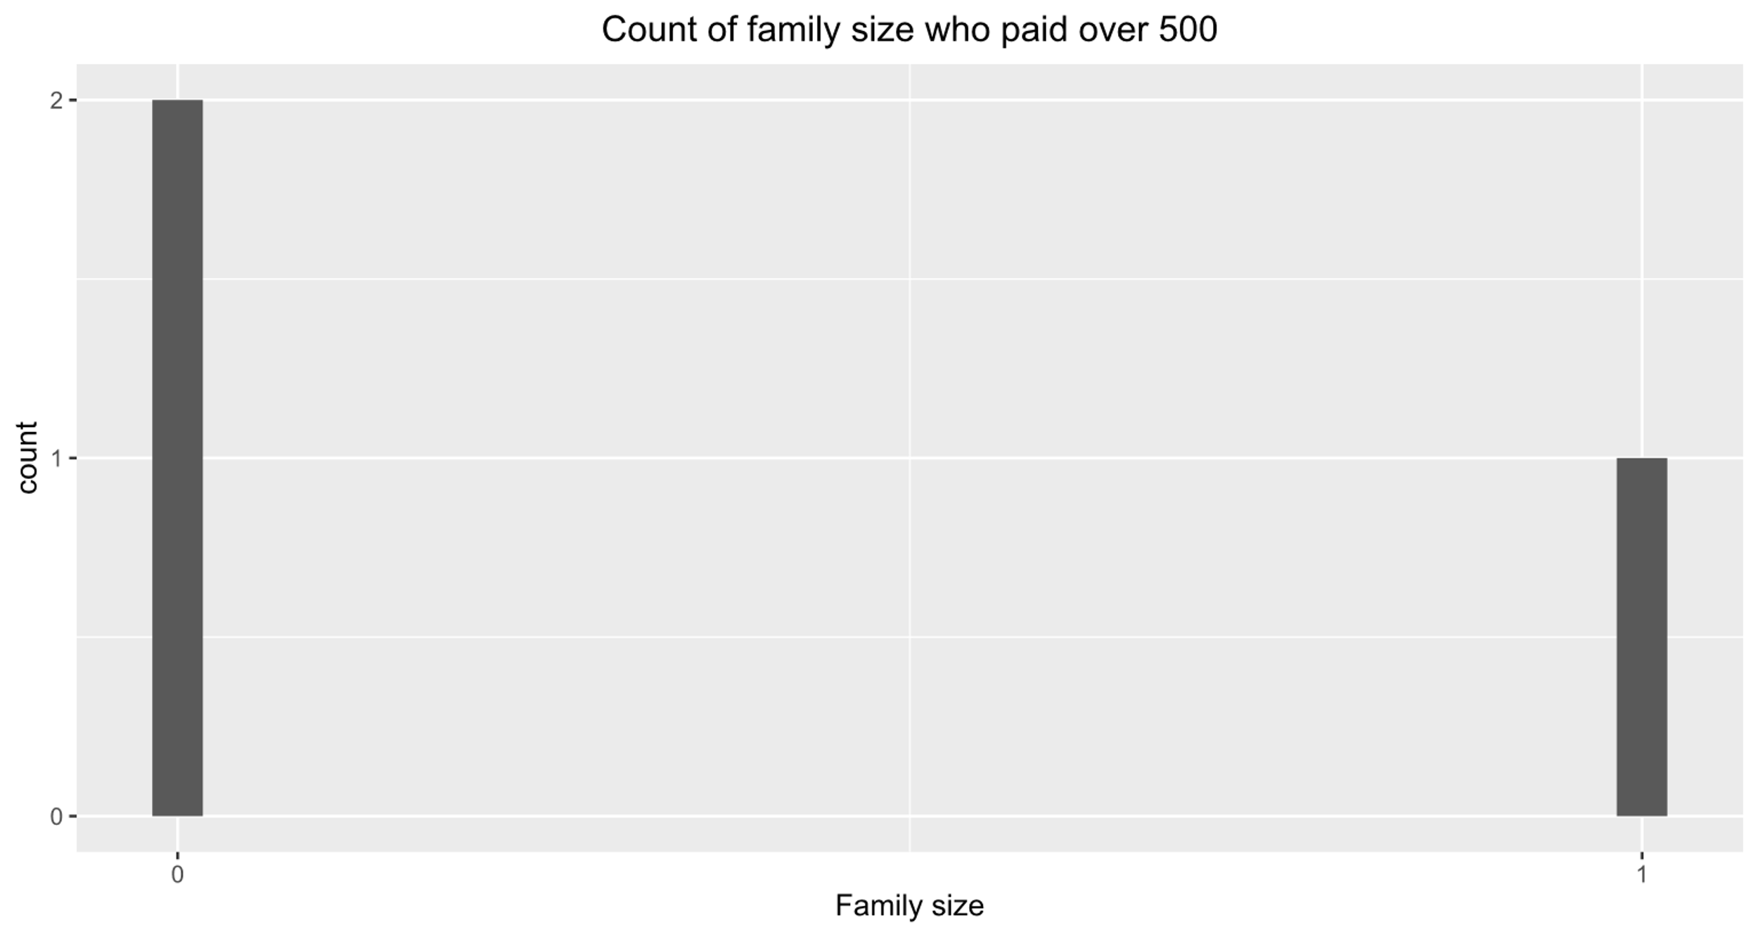
How many paid over 500?
Notes:
Axel
3 in total

Slide 11
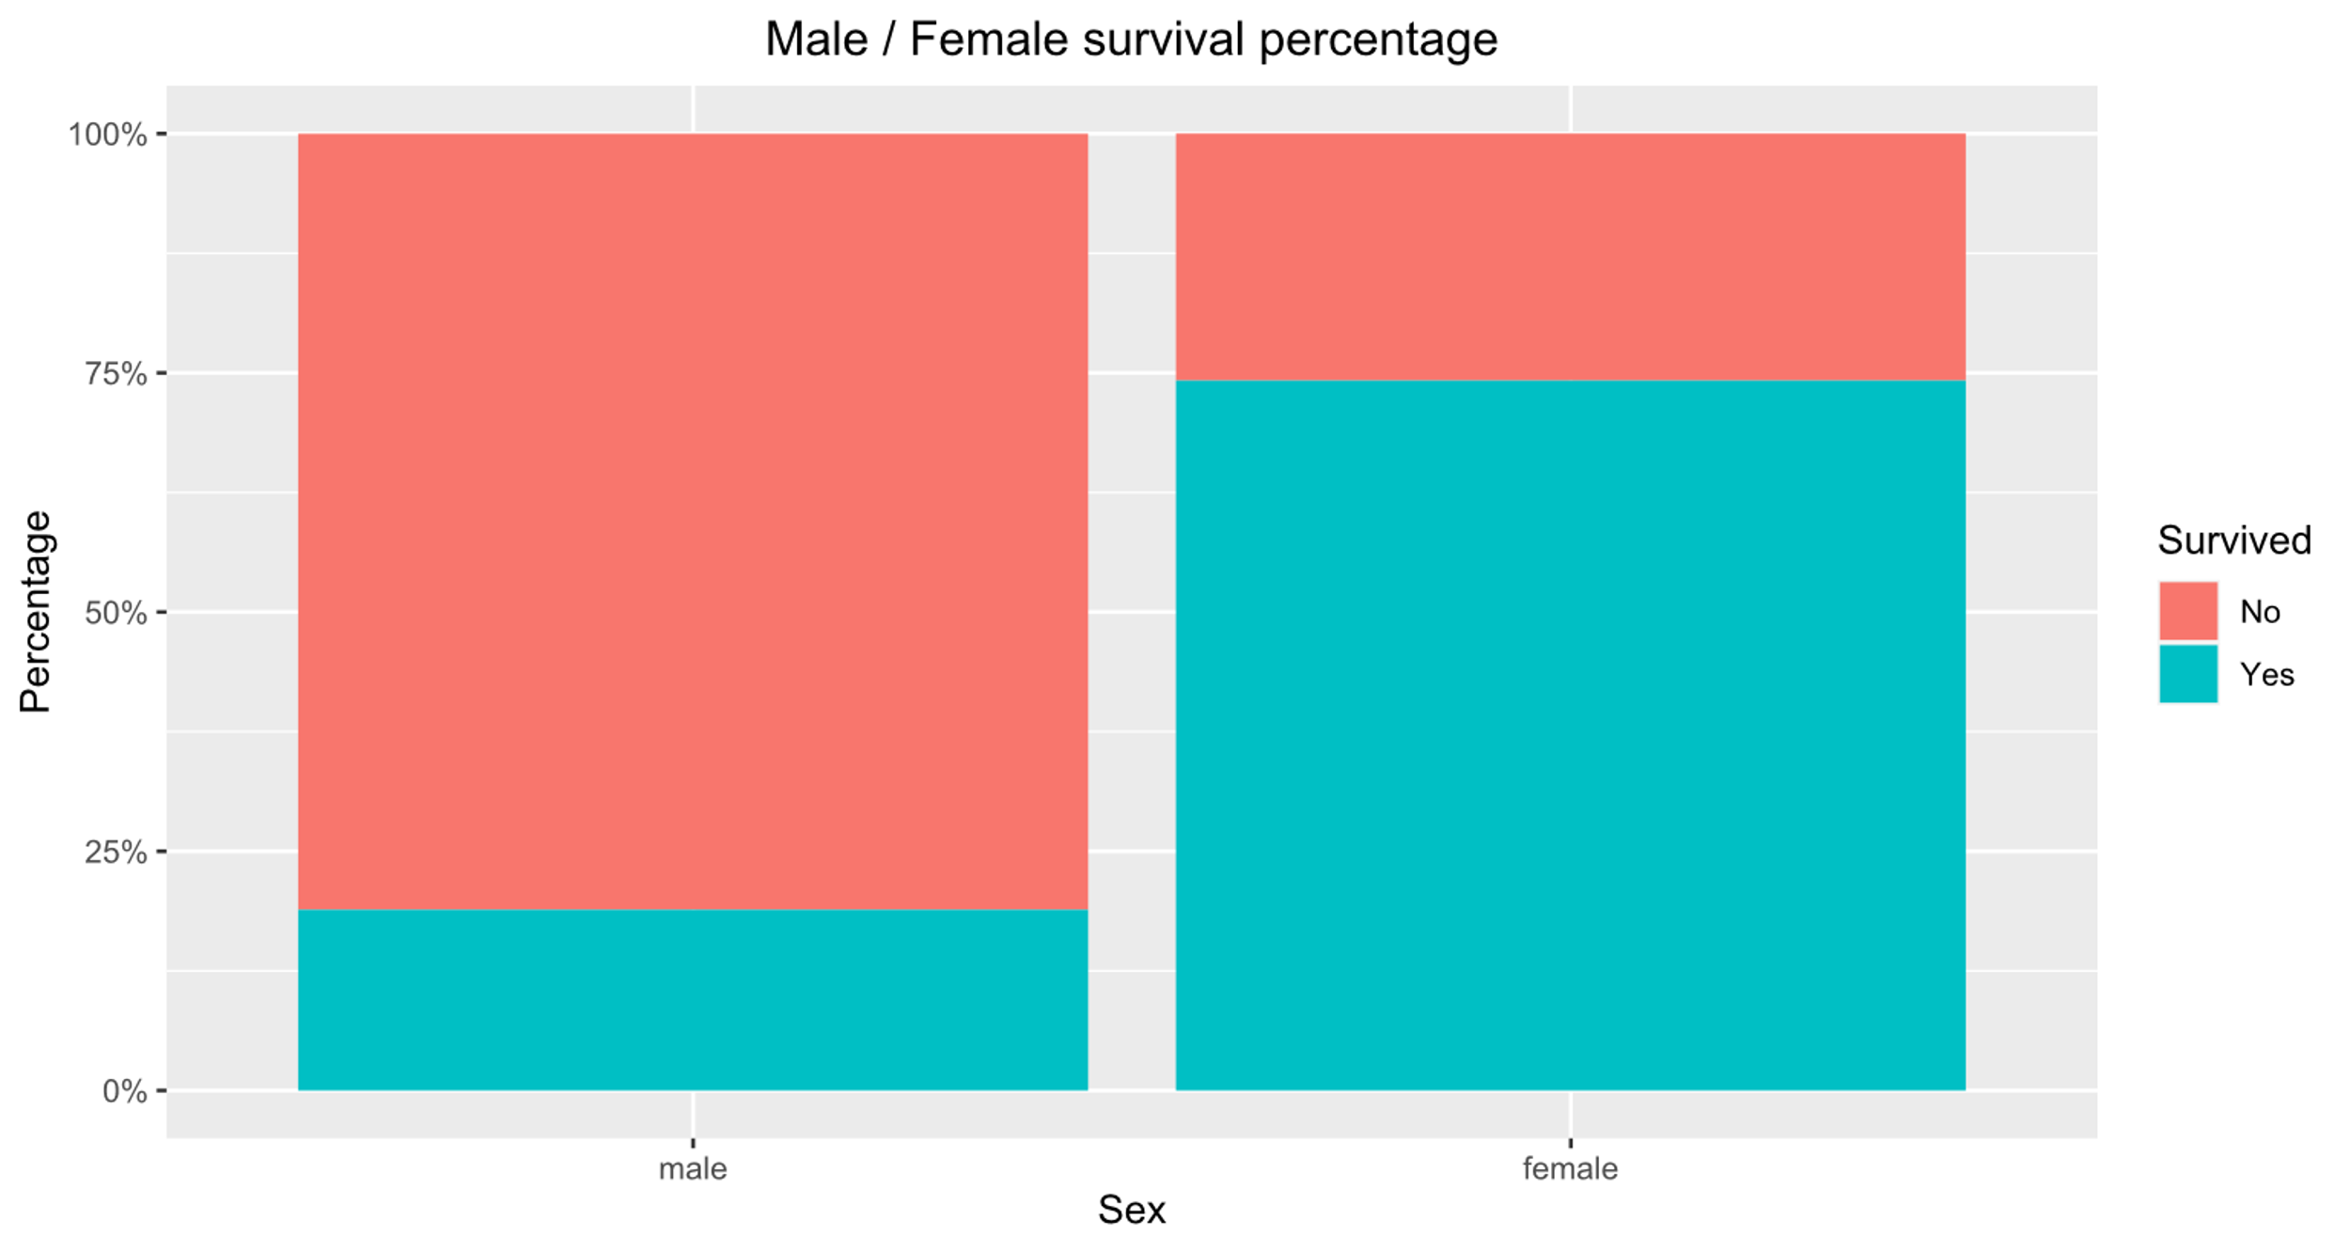
Women and children first?
Notes:
Axel
Male: +- 20%
Female: +- 74%

Slide 12
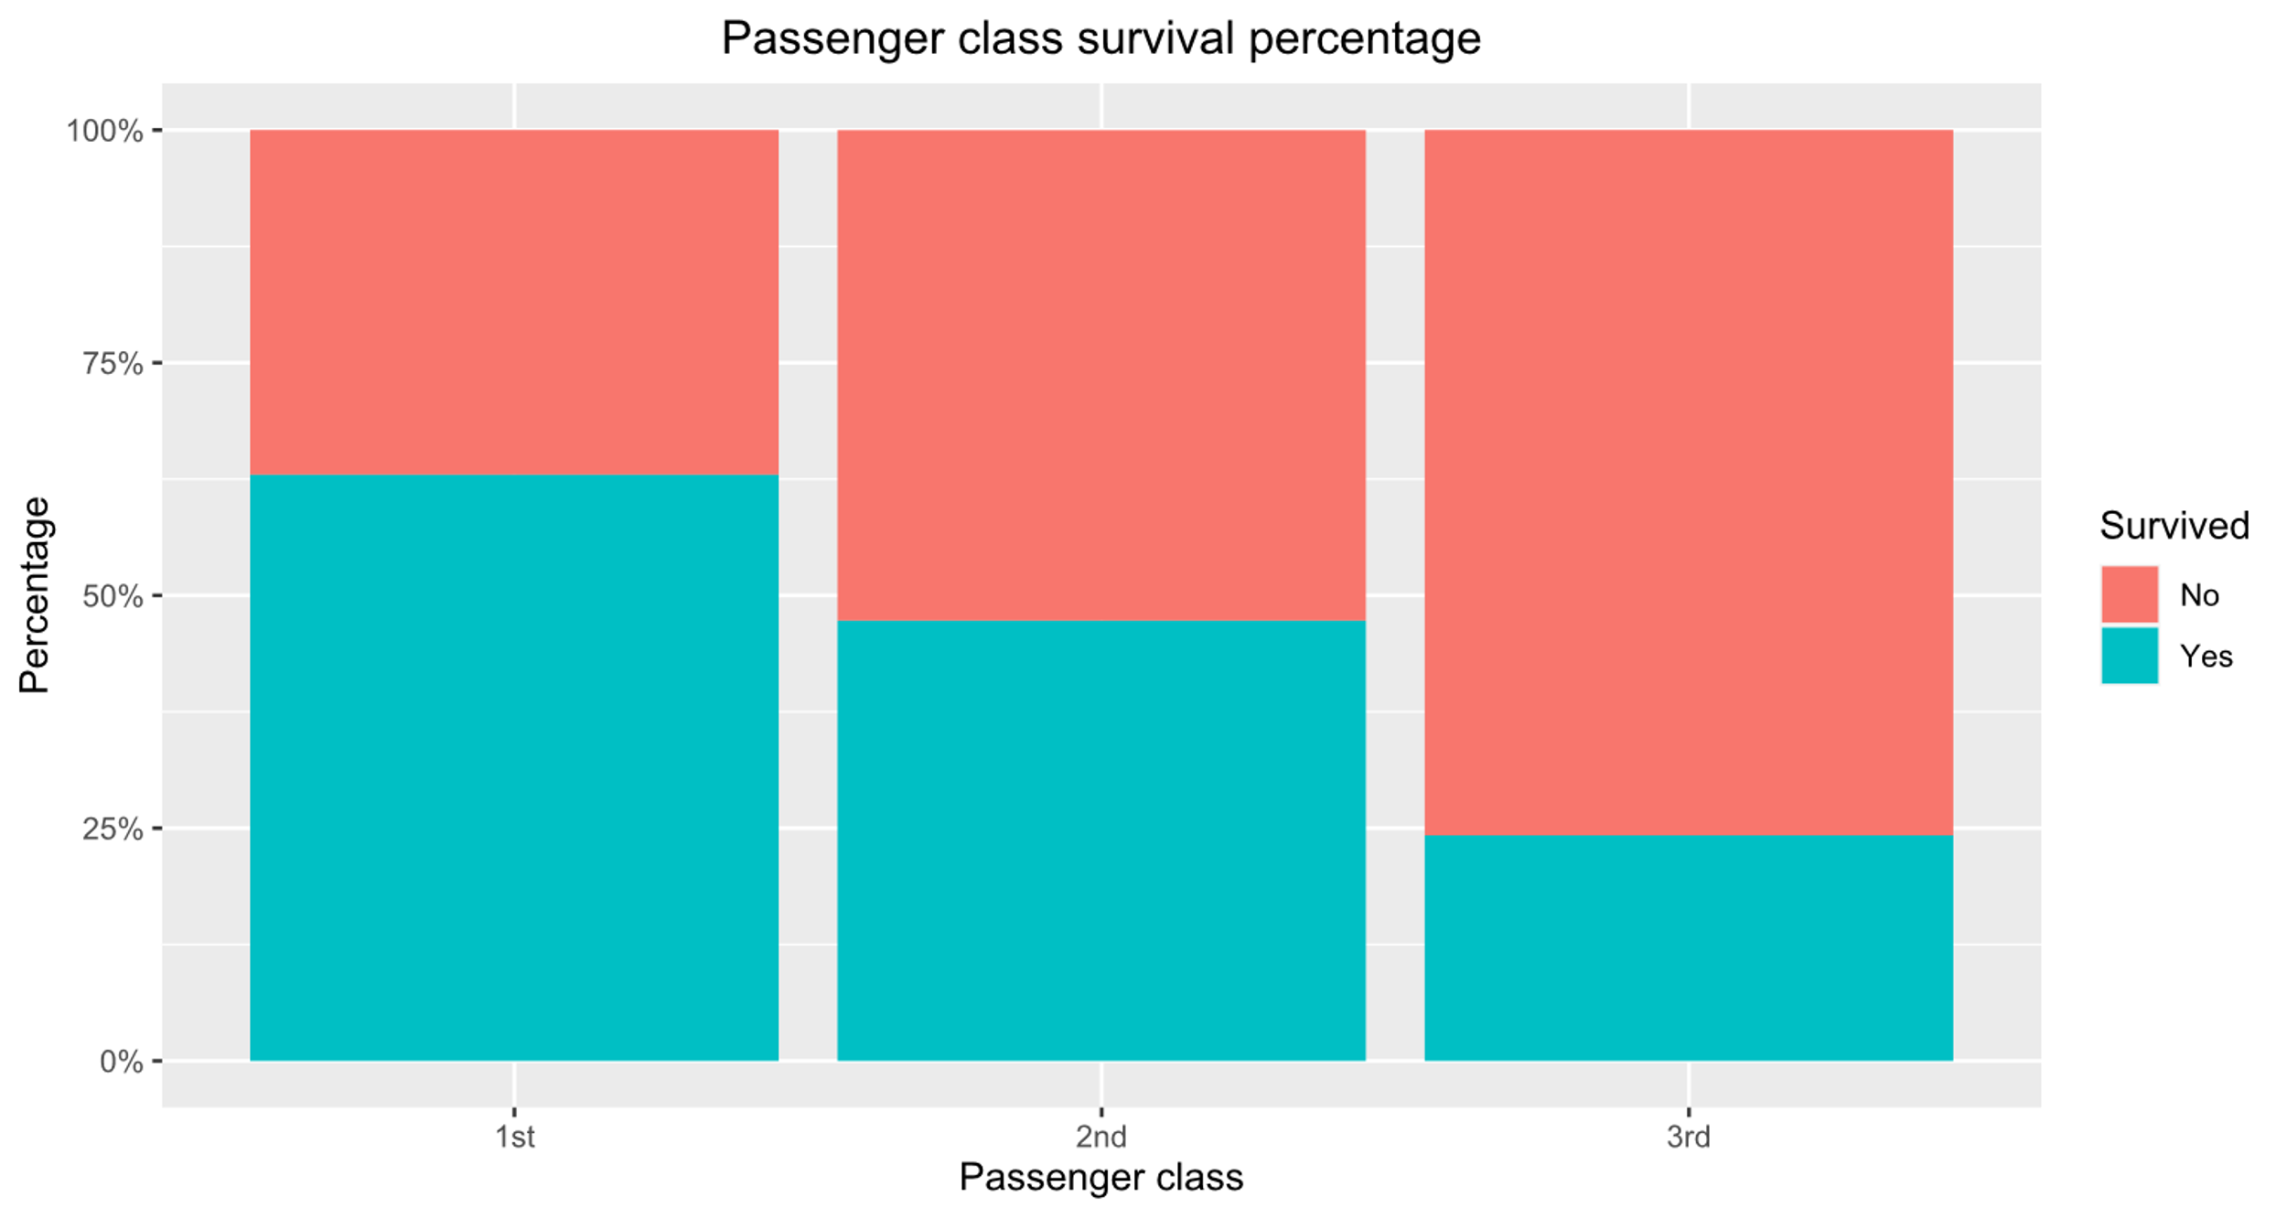
Class differences reflected in survival rate?
Notes:
Axel
Downwards trend
1st: +- 63%
2nd: +- 45%
3rd: +- 24%

Slide 13
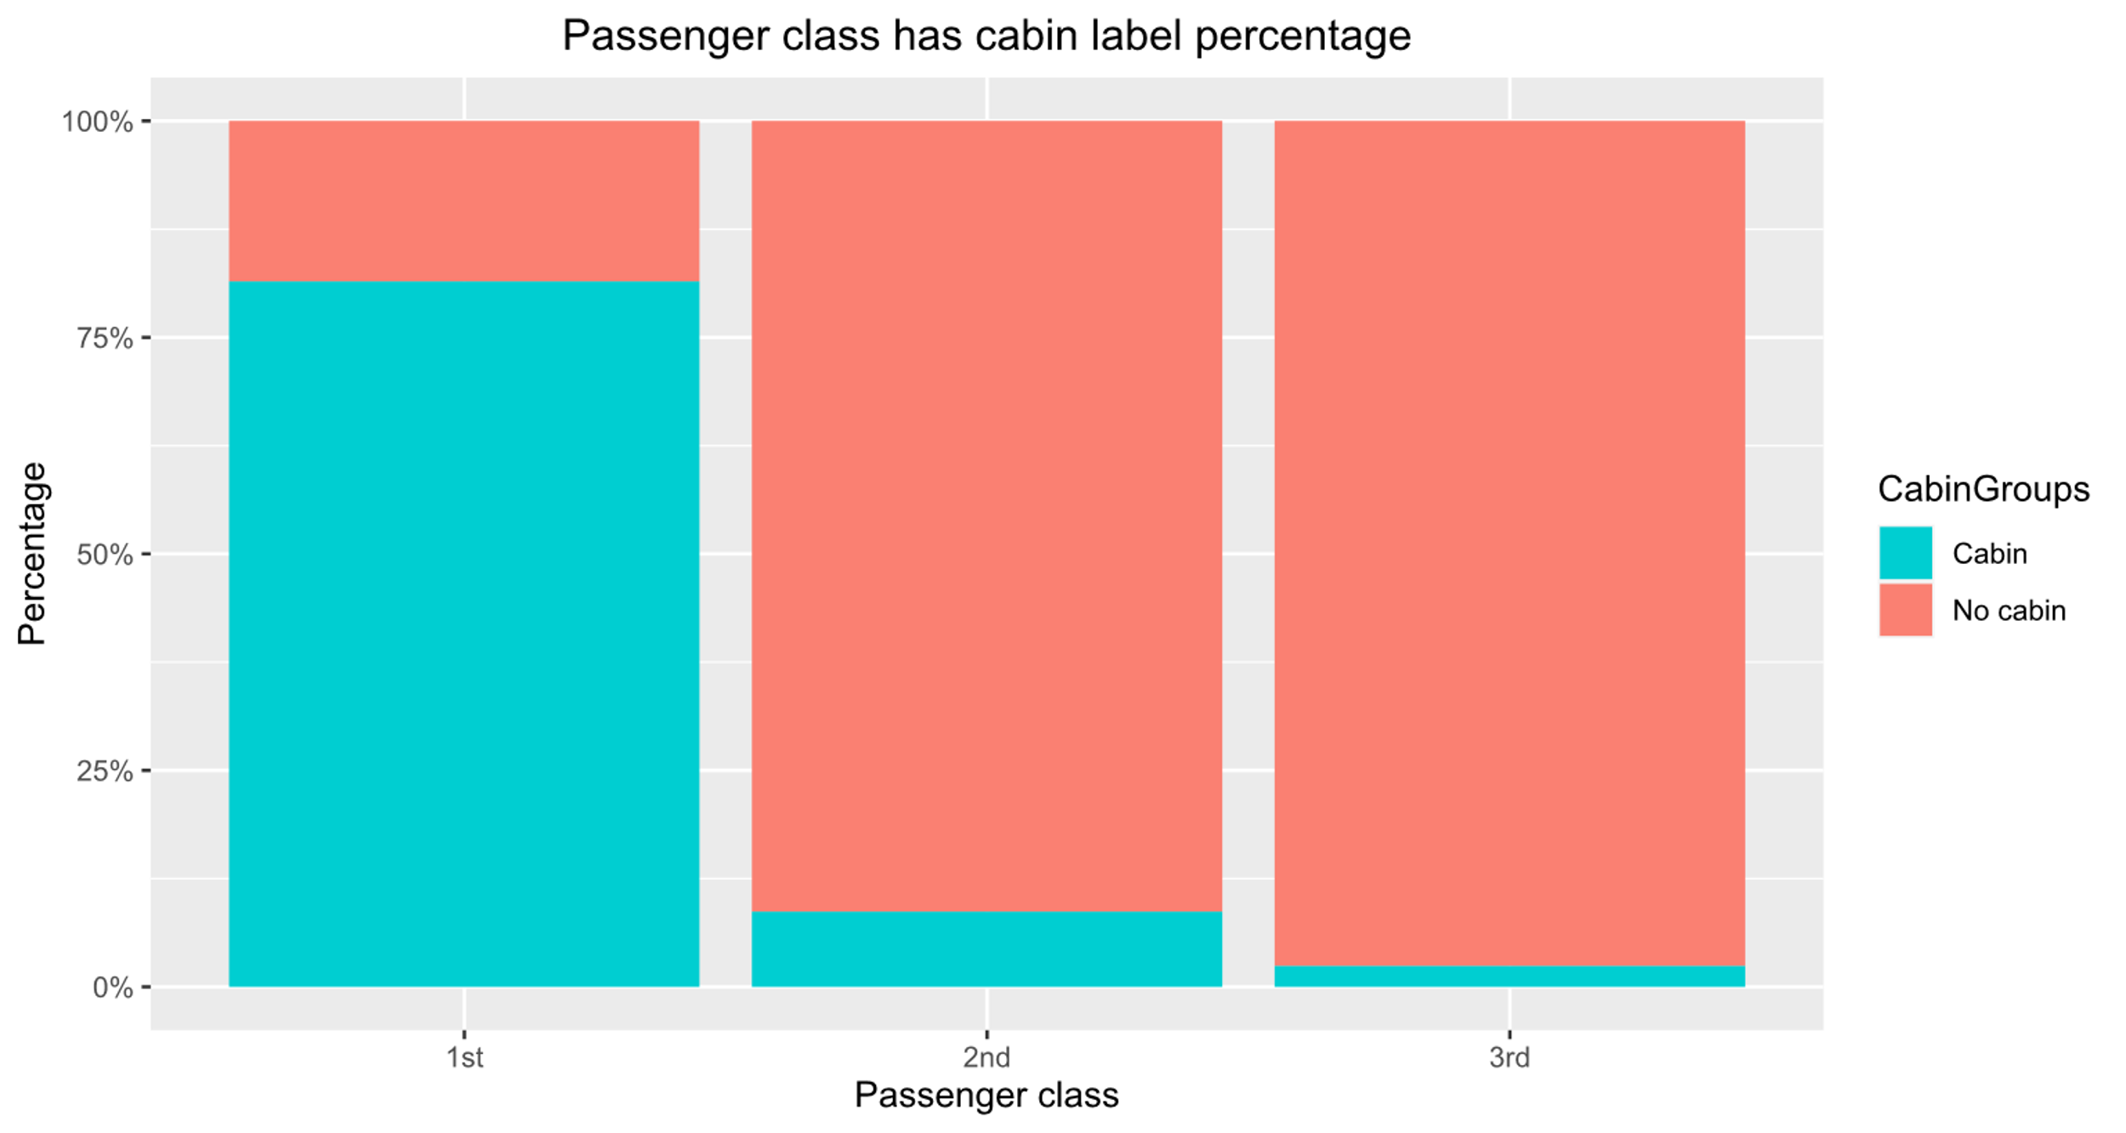
Passenger class has cabin label percentage
Notes:
Axel
1st class lots of cabin
2nd & 3rd not so much

Slide 14
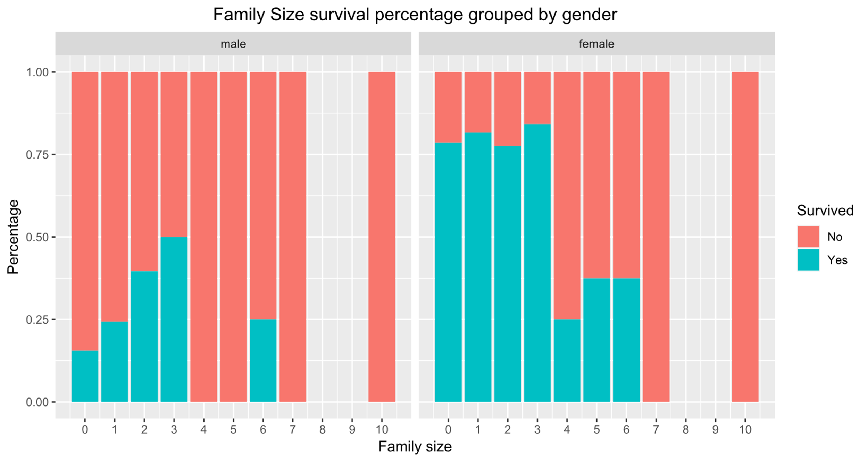
Impact family size on survival percentage
Notes:
Axel
Woman more inclined to help each other
Large drop-off after size of 3

Slide 15
Crop Dataset
Notes:
Jetze Luyten

Slide 16
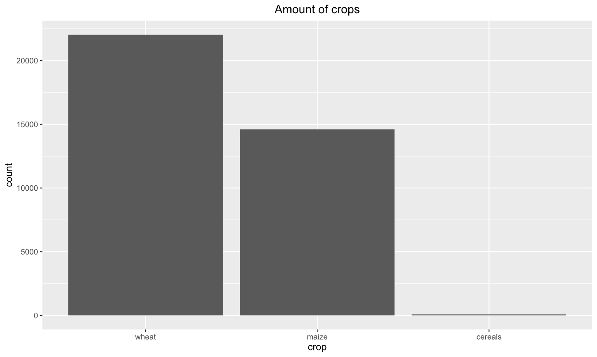
Amount of crops
Notes:
Jetze Luyten

Slide 17
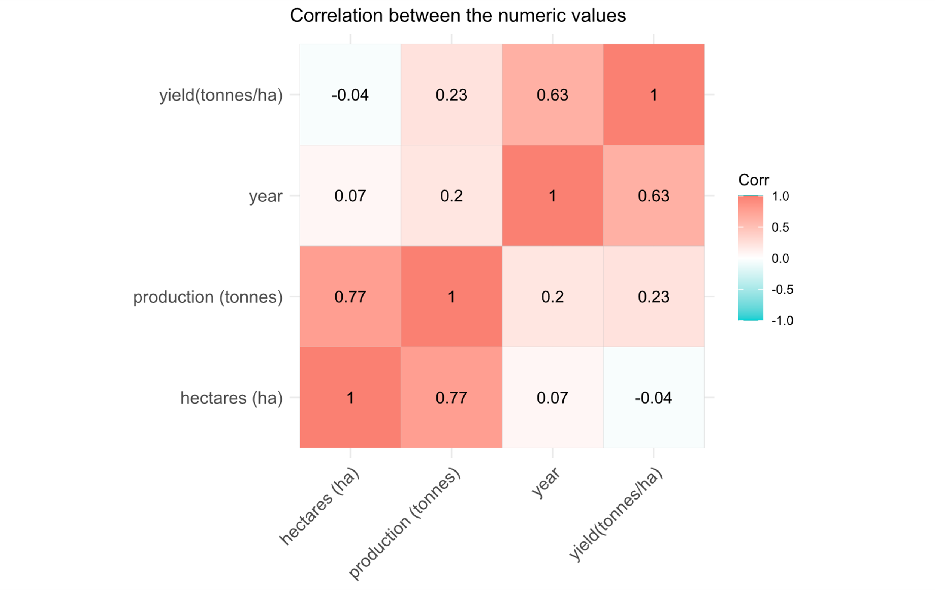
Correlation heatmap
Notes:
Jetze Luyten

Slide 18
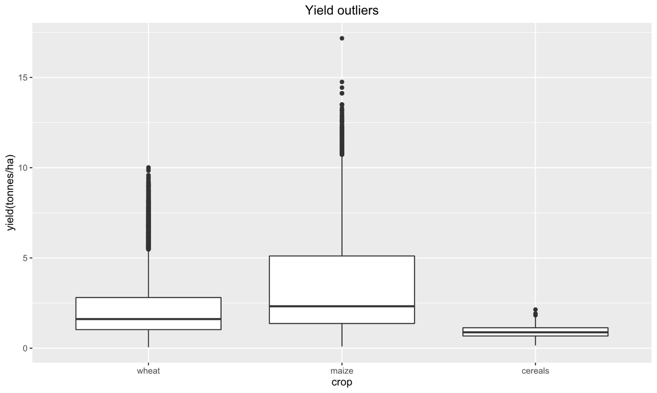
Yield of outliers
Notes:
Jetze Luyten

Slide 19
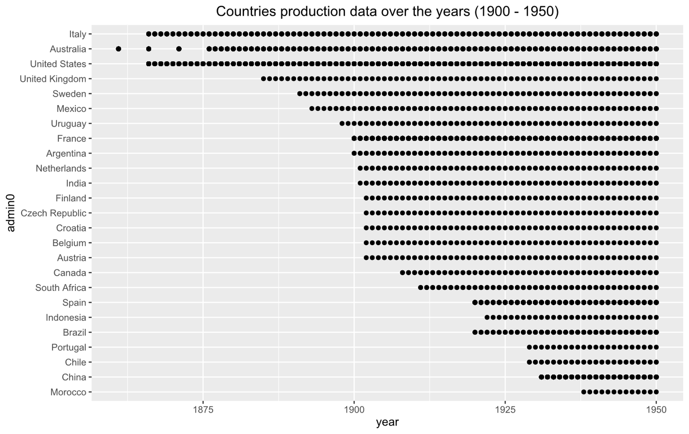
Section 1 from 1900 - 1950
Notes:
David

Slide 20
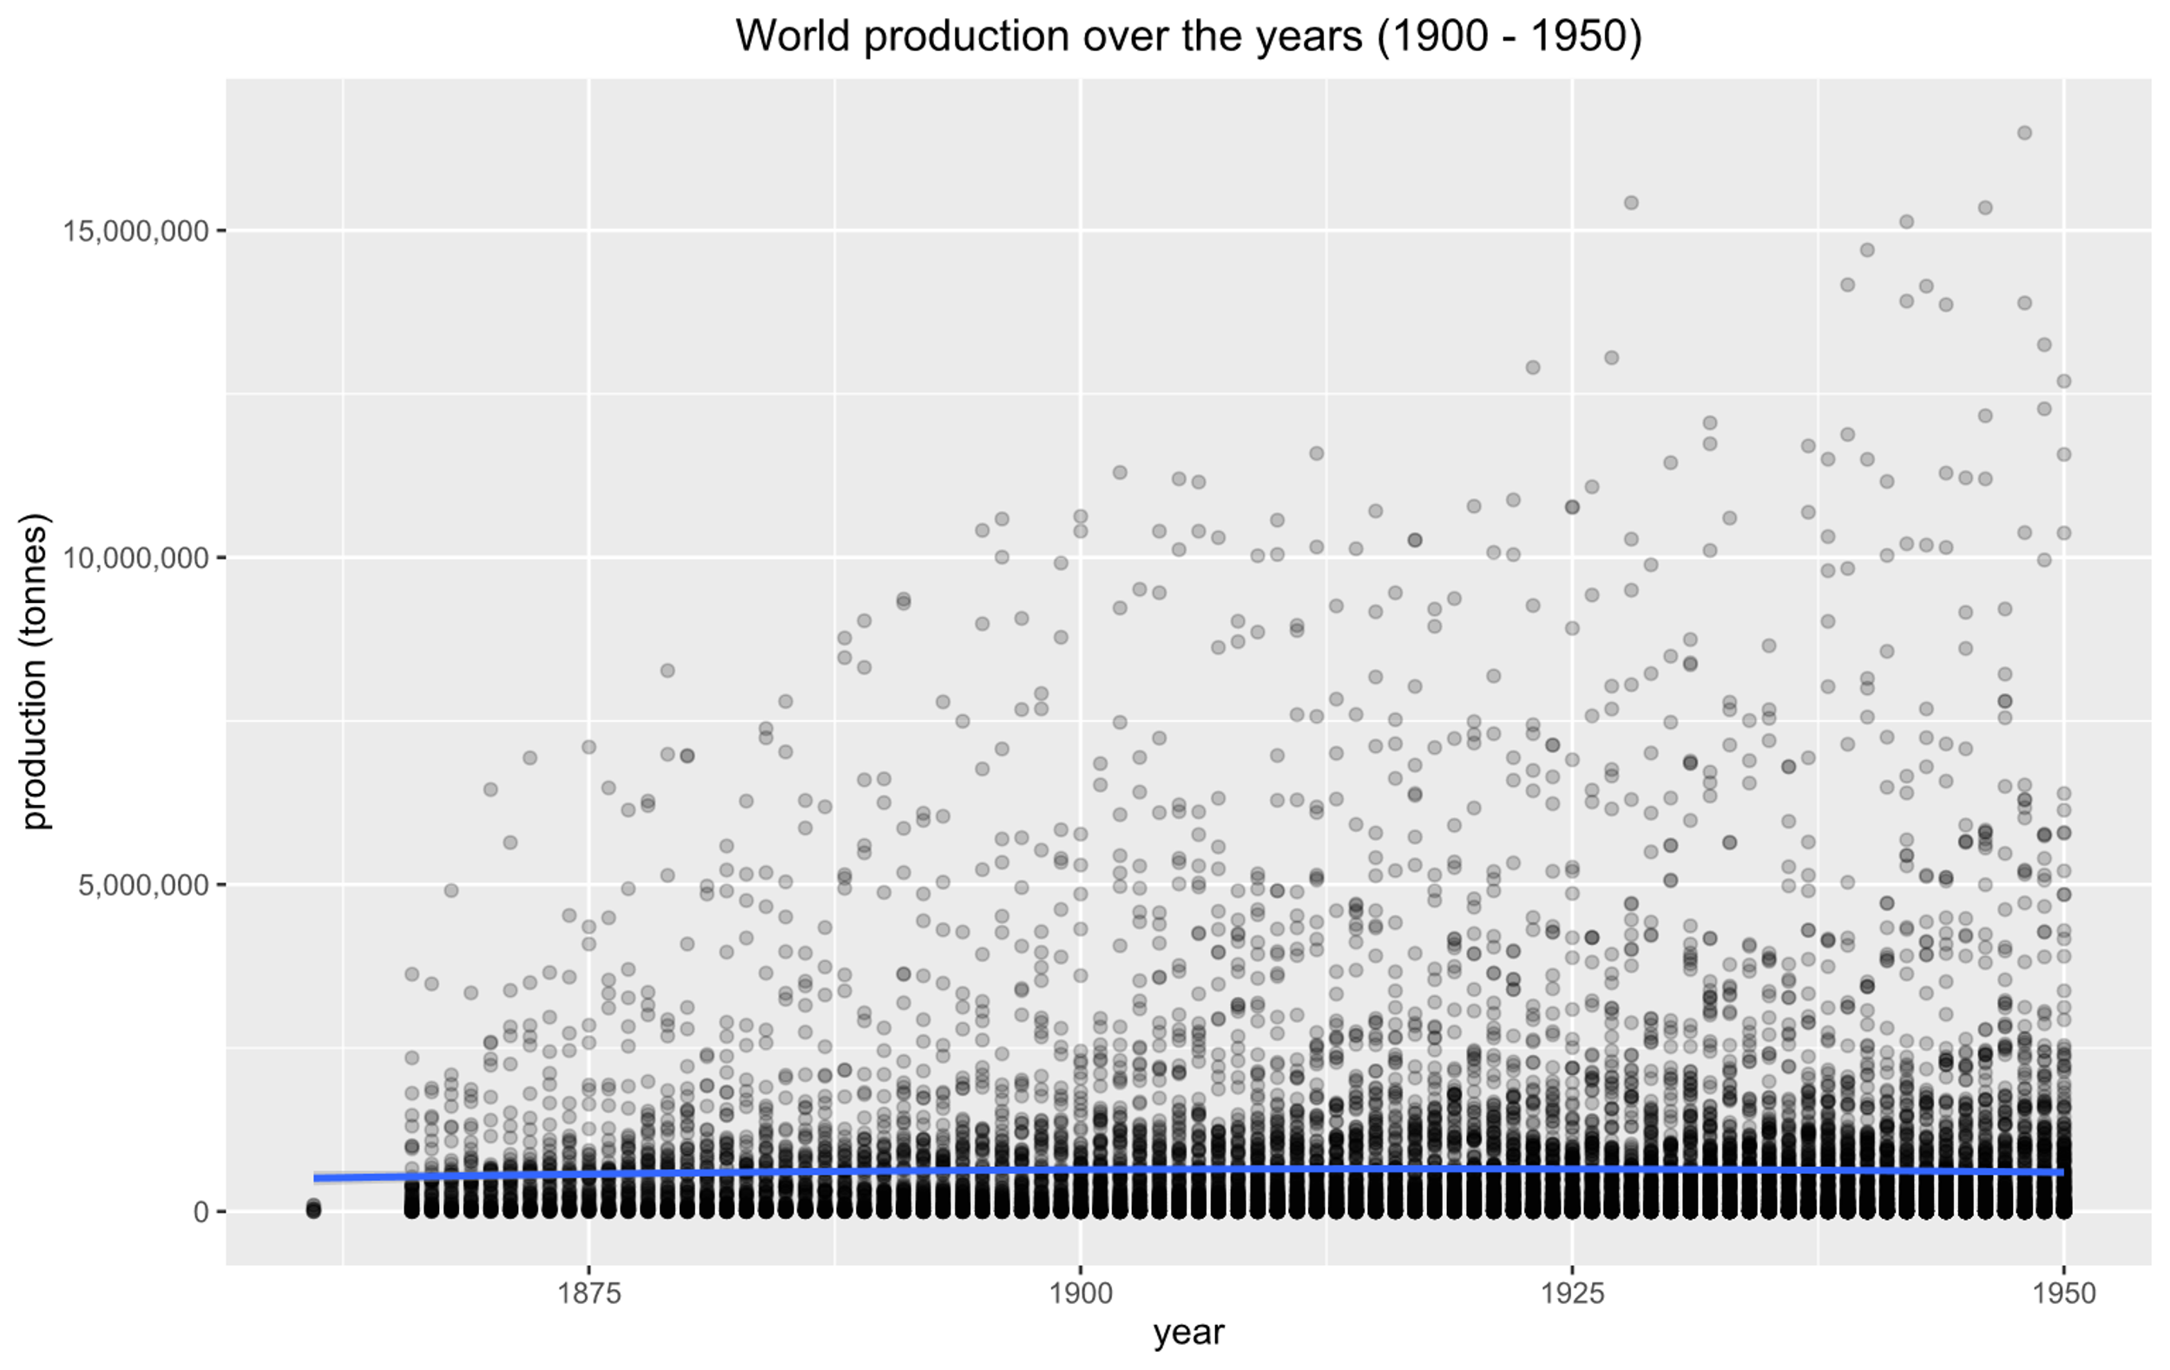
Section 1 from 1900 - 1950
Notes:
David

Slide 21
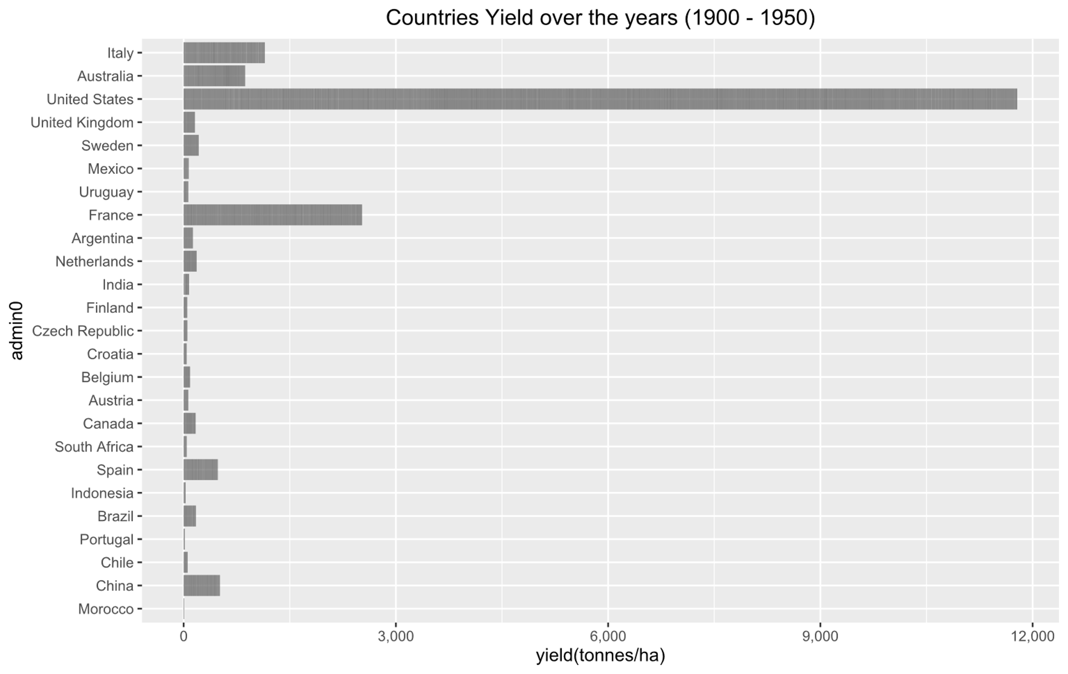
Section 1 from 1900 - 1950
Notes:
David

Slide 22
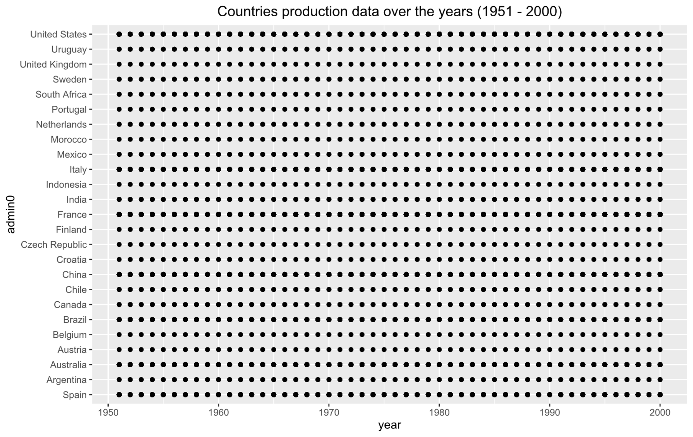
Section 2 from 1951 - 2000
Notes:
David

Slide 23
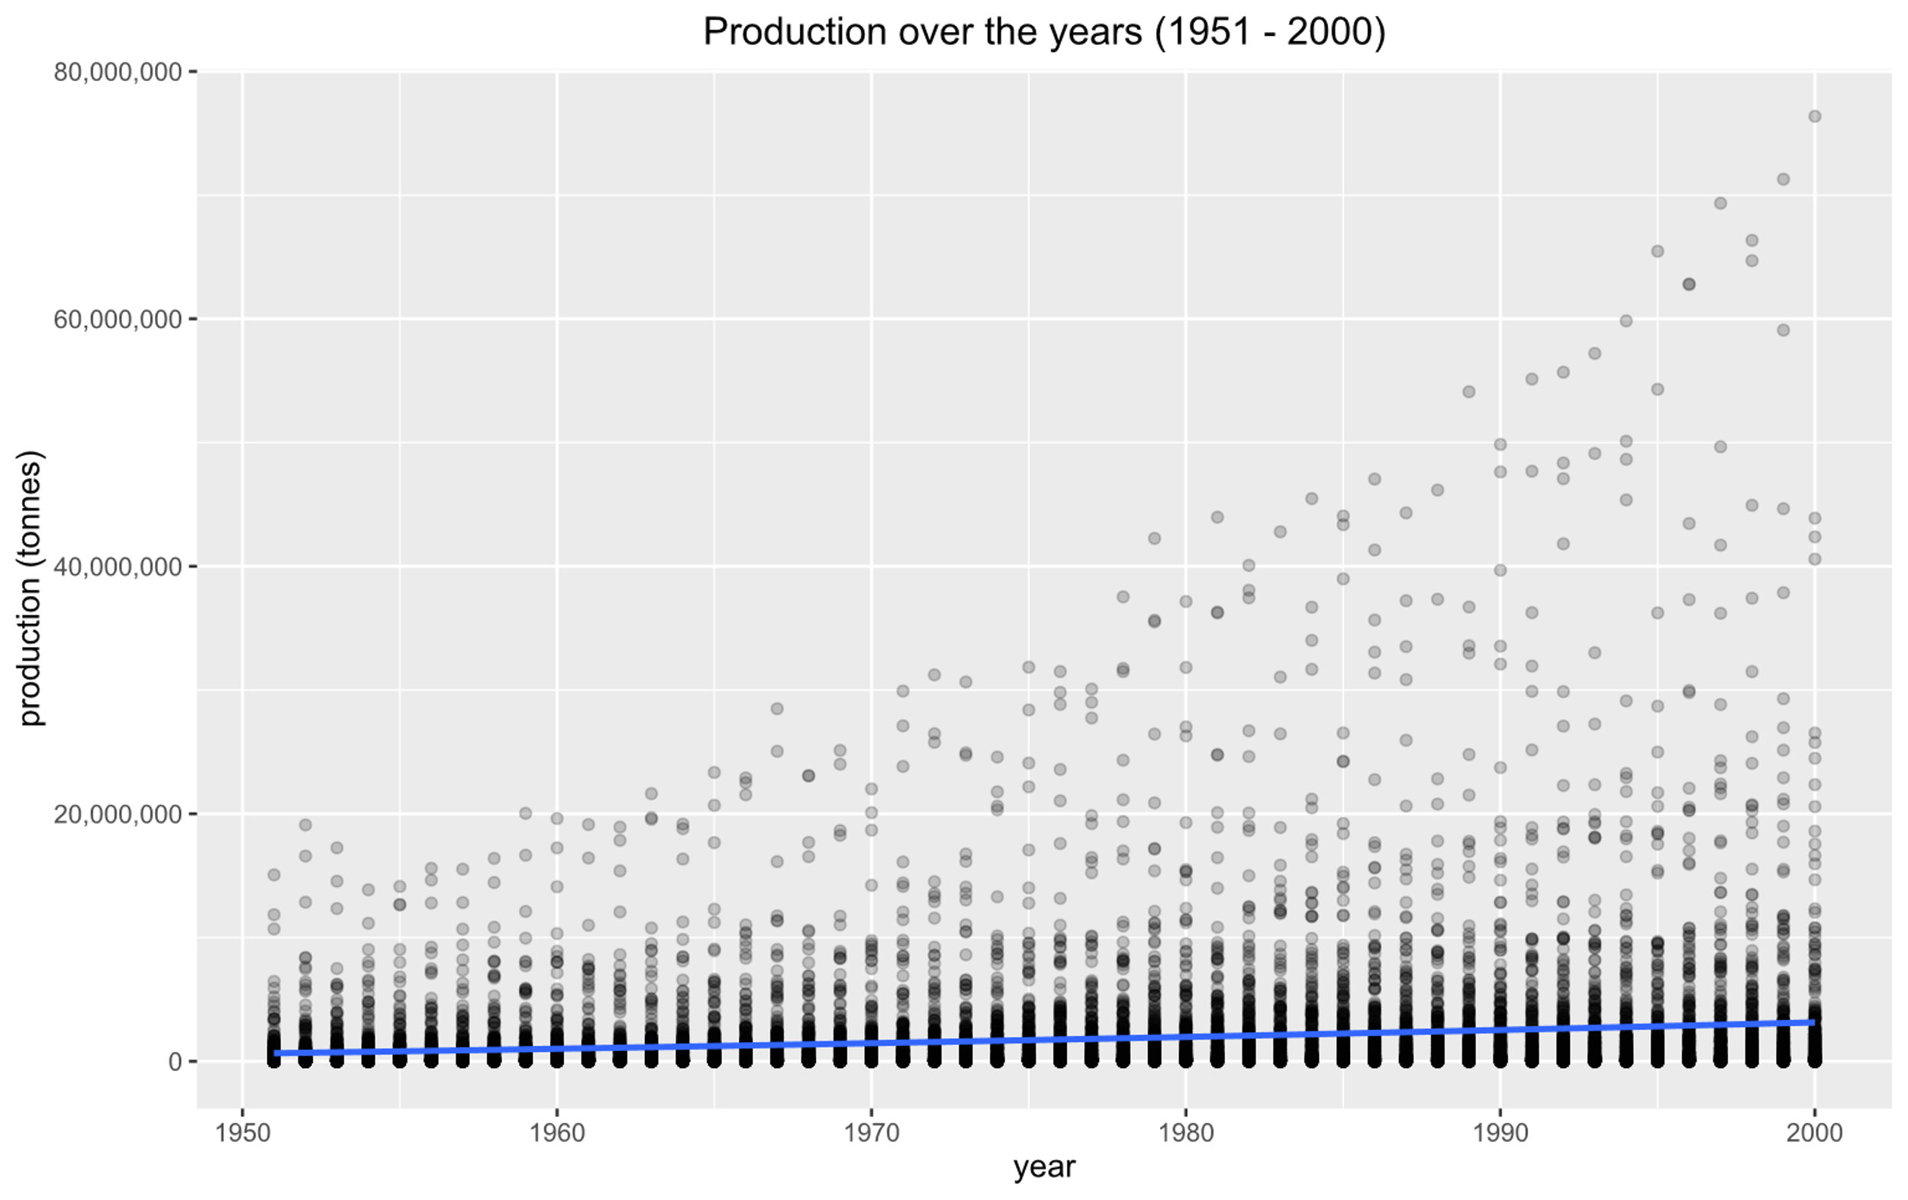
Section 2 from 1951 - 2000
Notes:
David

Slide 24
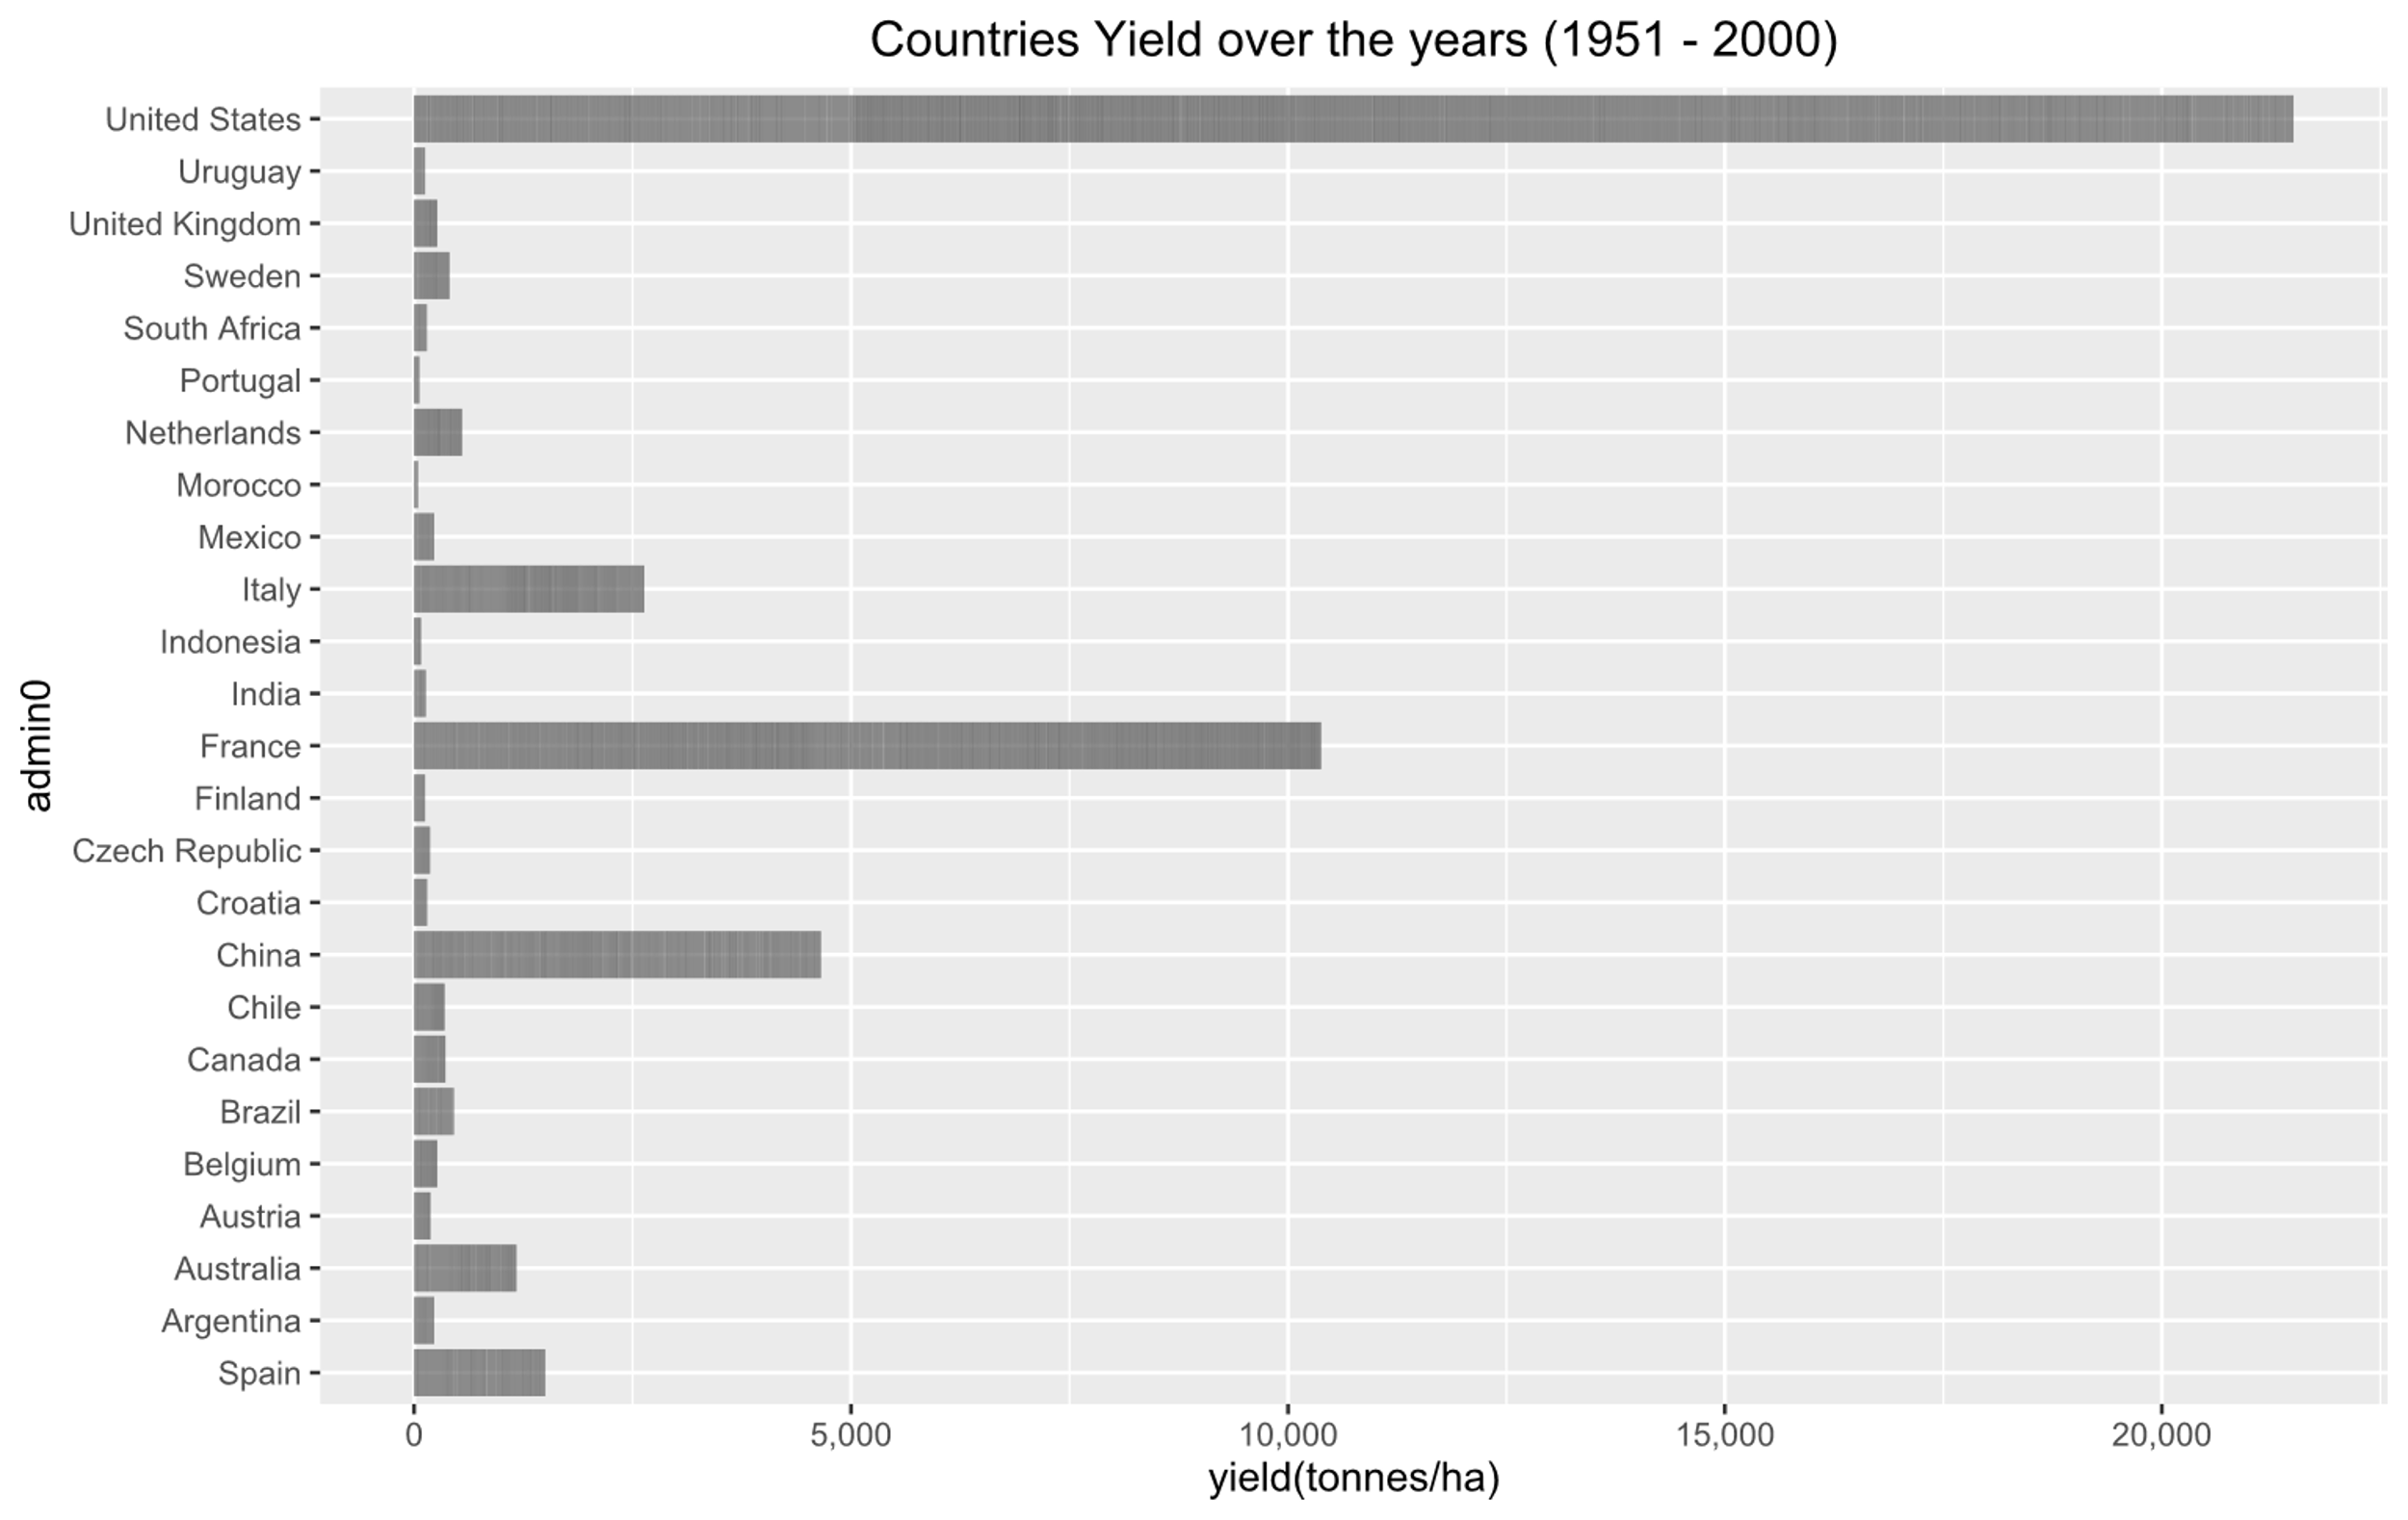
Section 2 from 1951 - 2000
Notes:
David

Slide 25
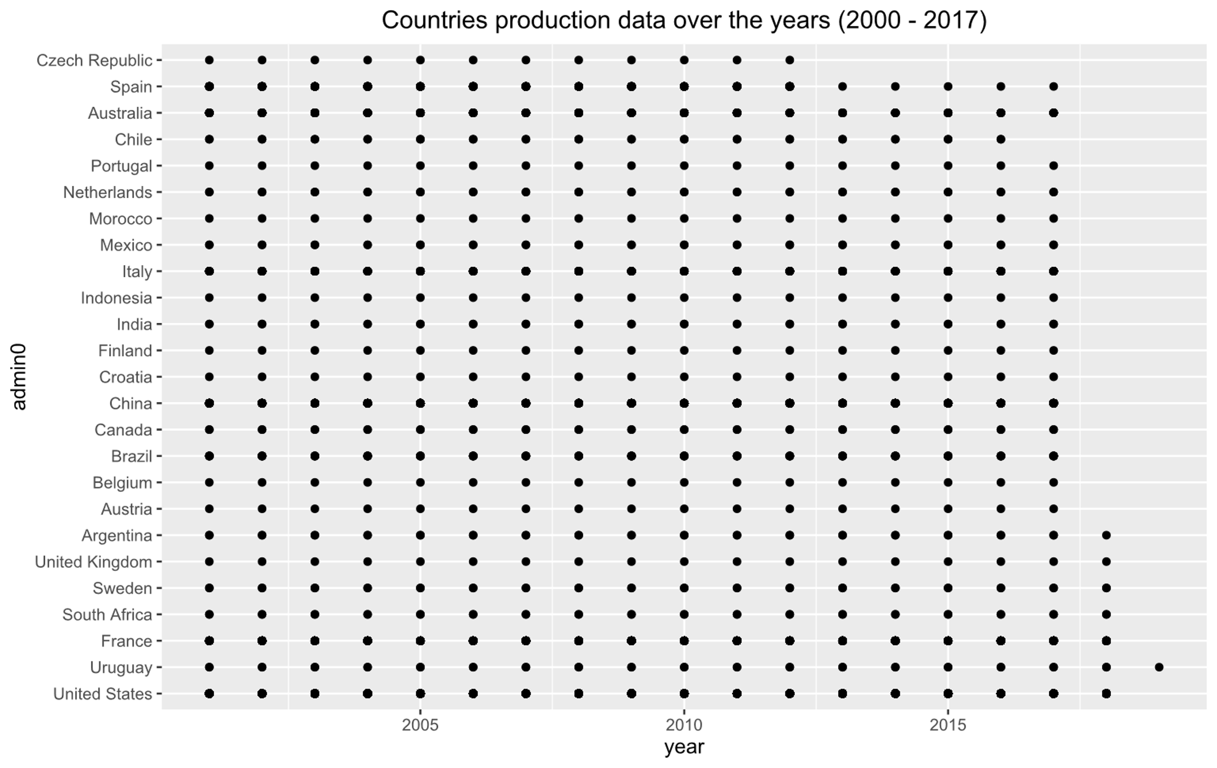
Section 3 from 2001 - 2017
Notes:
David

Slide 26
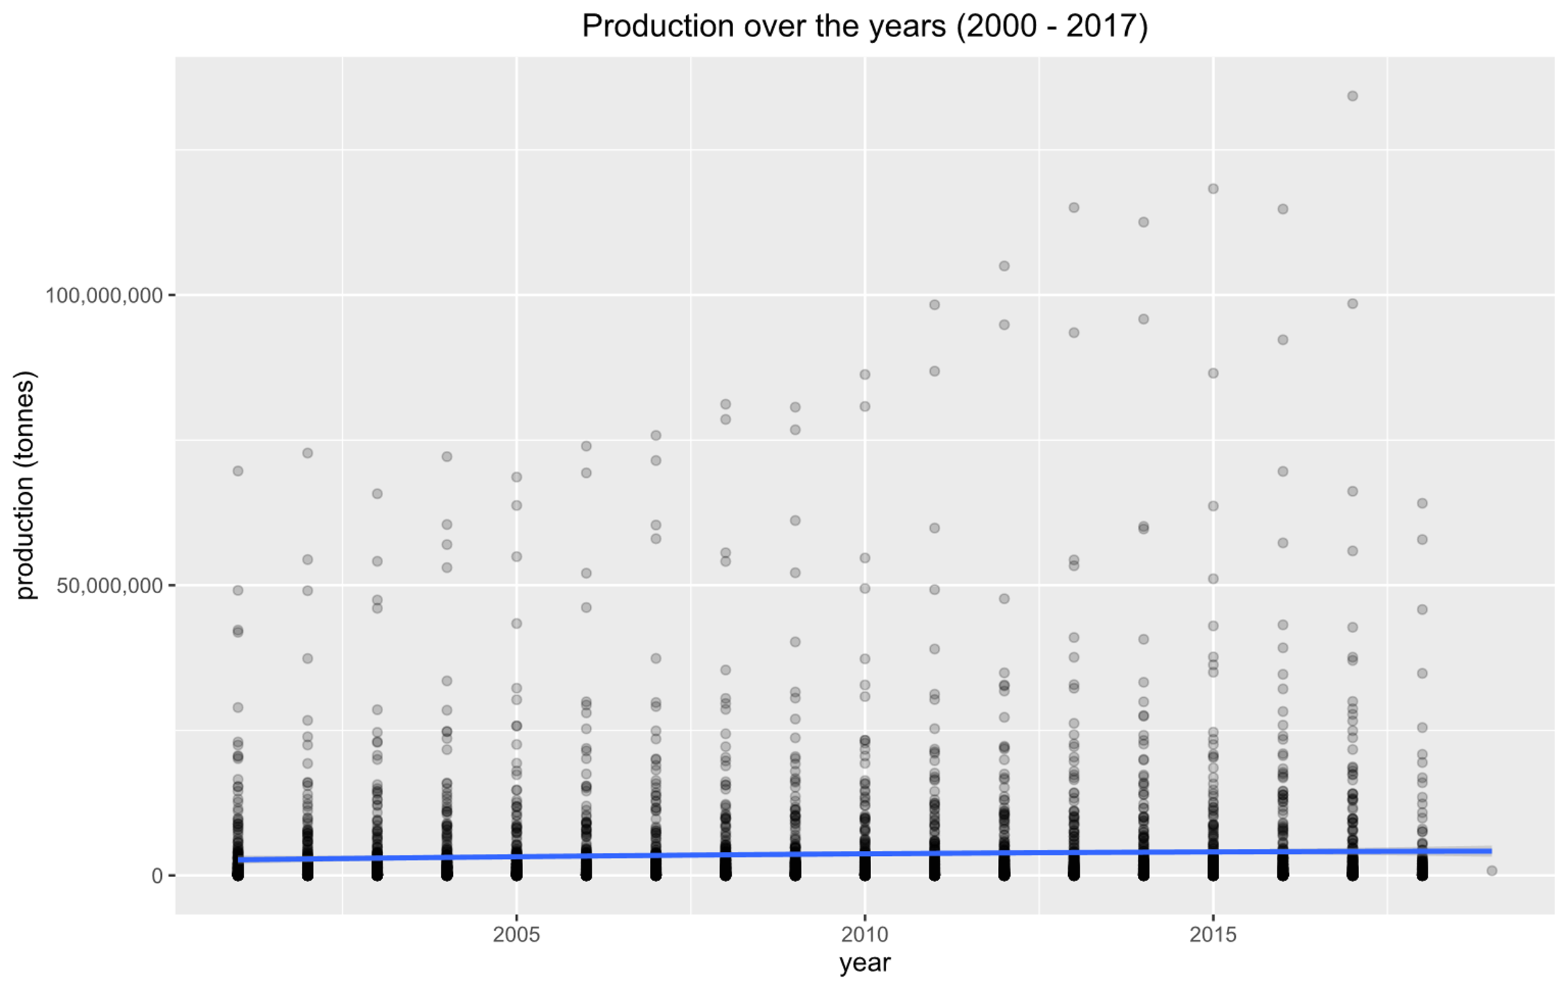
Section 3 from 2001 - 2017
Notes:
David

Slide 27
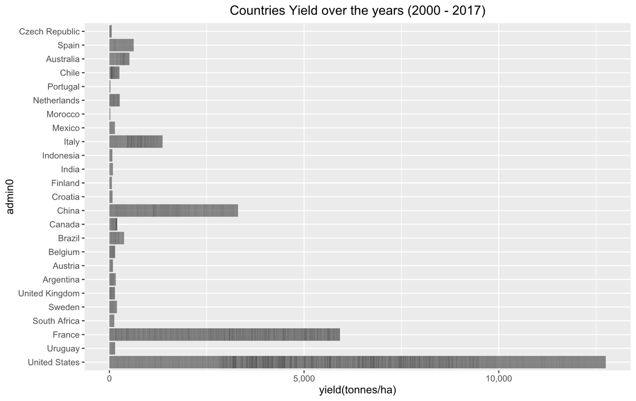
Section 3 from 2001 - 2017
Notes:
David

Slide 28
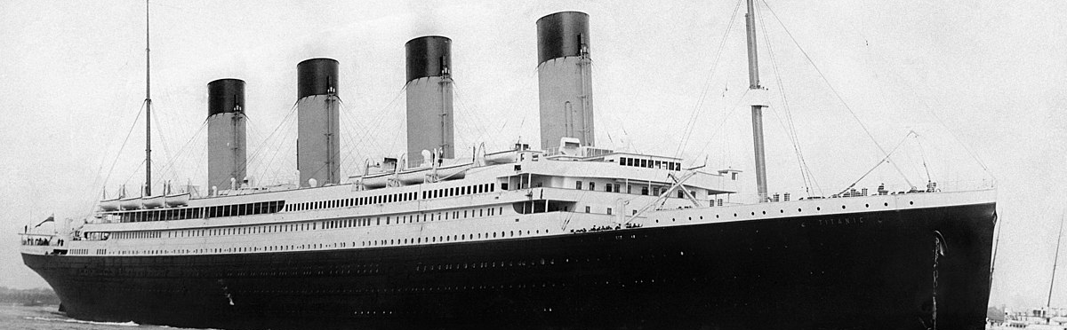
Summary
Notes:
Jetze Luyten

Slide 29

Thank You
Any questions?
JAD Solutions
Notes:
Jetze Luyten

